Slide 1
Microsoft Power BI

Slide 2
Advanced Dataset Programming with Power BI
Ted Pattison
Principal Program Manager
Power BI Customer Advisory Team (PBICAT)

Slide 3
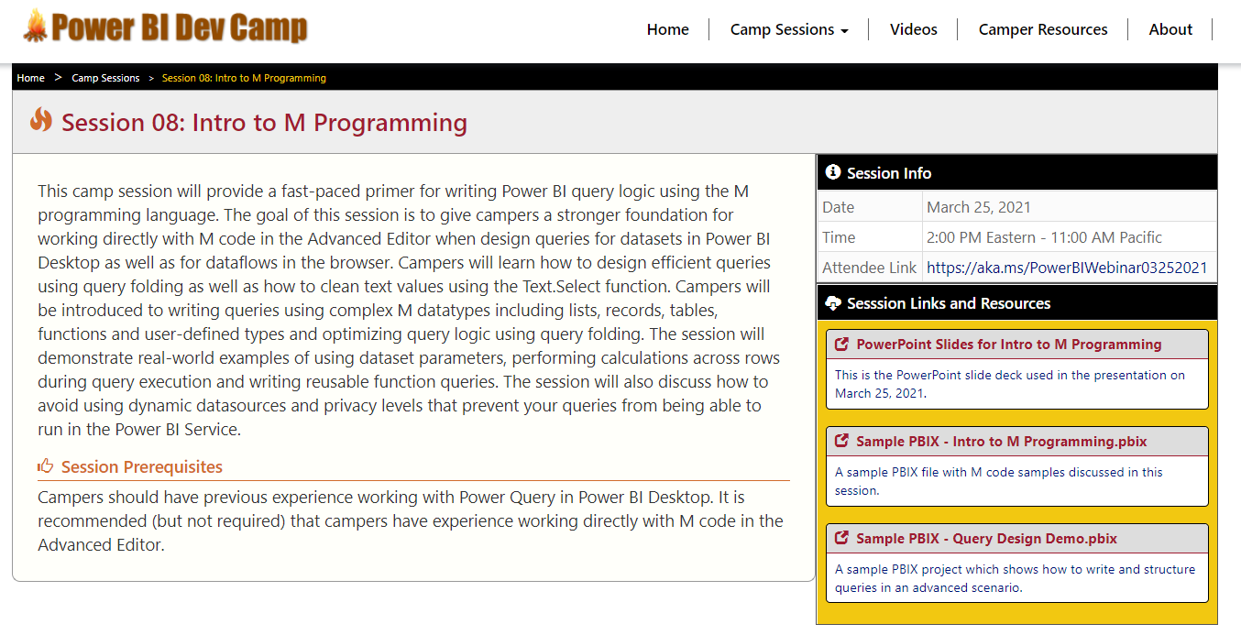
Welcome to Power BI Dev Camp
Power BI Dev Camp Portal - https://powerbidevcamp.net

Slide 4
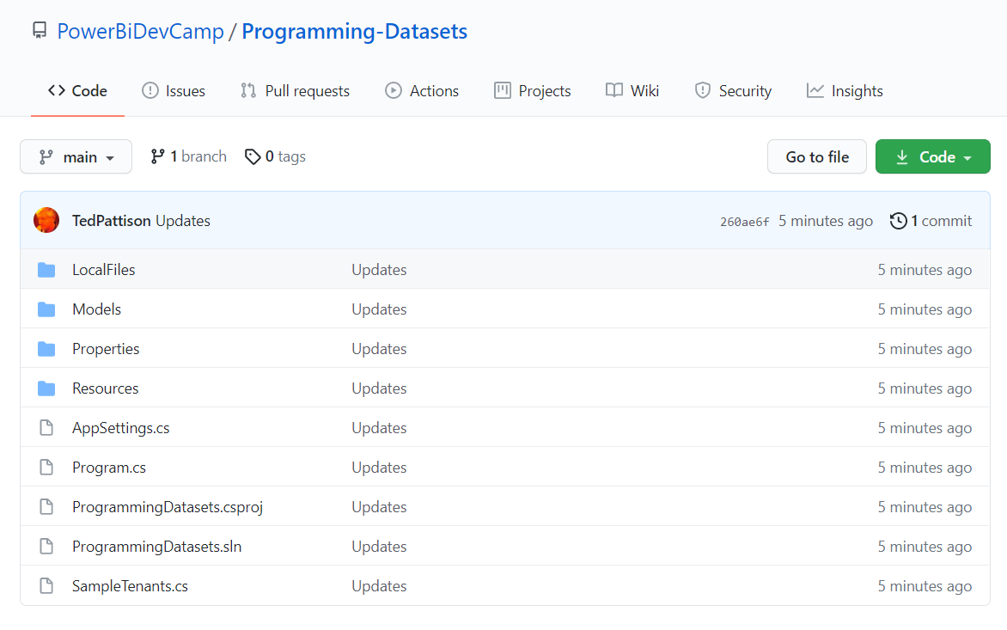
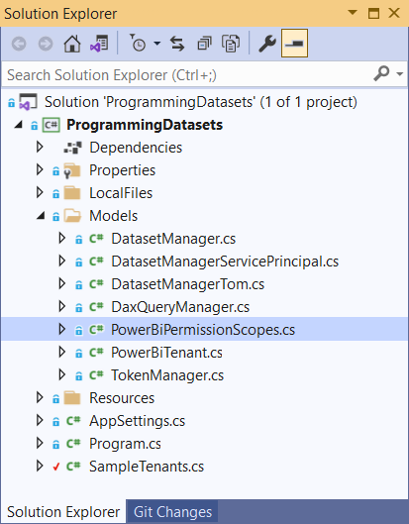
Sample code for this session in C# console app
https://github.com/PowerBiDevCamp/Programming-Datasets

Slide 5
Agenda
Power BI Dataset Programming Overview
Programming Datasets with the PBI REST API
Programming Datasets as Service Principal
Programming Datasets using Tabular Object Model
Scaling with App-Owns-Data in Multi-tenant Scenarios

Slide 6
Power BI Dataset Programming Overview
Two different APIs support programming datasets in Power BI
Power BI REST API – original API introduced in 2015
Tabular Object Model (TOM) via XMLA Endpoint – new API introduced in 2021
developer APIs for programming Power BI datasets
Power BI REST API
Tabular Object Model
Create workspaces
Manage workspaces
Power BI Embedding
Generate Embed Tokens
Set datasource credentials
Program reports
Program dashboards
Execute DAX queries
Clone and author datasets
Create new tables from scratch
Create and assign RLS Roles
Create/read translations
Replacing M code for table partition
Creating datasets
Update parameters
Start refresh operations

Slide 7
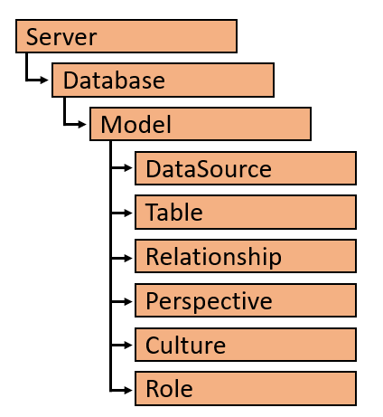
Tabular Object Model (TOM)
TOM is extension of Analysis Management Object (AMO) client library
created to support programming scenarios for tabular models
Newly added support for datasets in Power BI Desktop and the Power BI Service
TOM provides a programmatic way to view/edit data models
creating models
importing and refreshing data
assigning roles and permissions
TOM requires two assemblies
Microsoft.AnalysisServices.Core
Microsoft.AnalysisServices.Tabular.dll

Slide 8
Authenticating with Azure AD
Custom applications must authenticate with Azure AD
Your code implements and authentication flow to obtain access token
Access token must be passed when calling Power BI Service API
Azure Active Directory
Custom App
Access Token
Access Token
Power BI Service

Slide 9
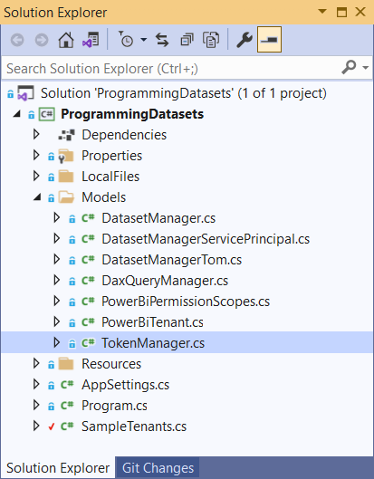
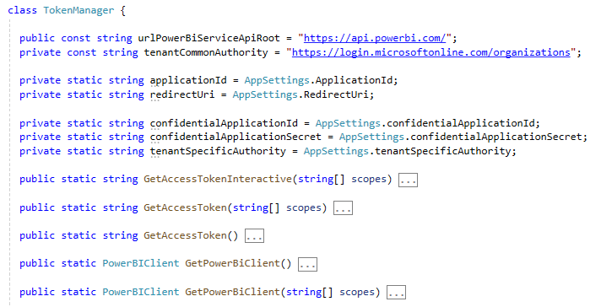
TokenManager class implements authentication flows

Slide 10
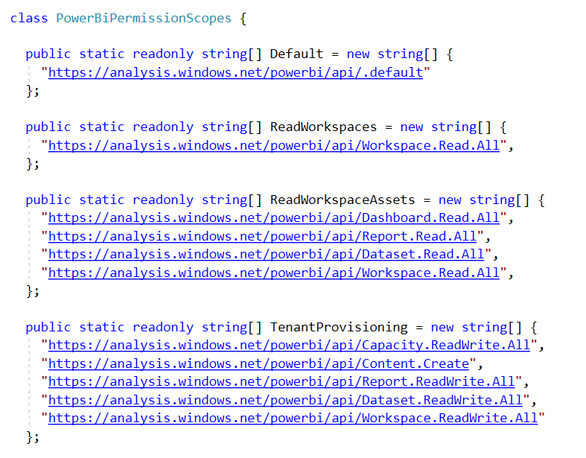
Power BI - Delegated Permission Scopes

Slide 11
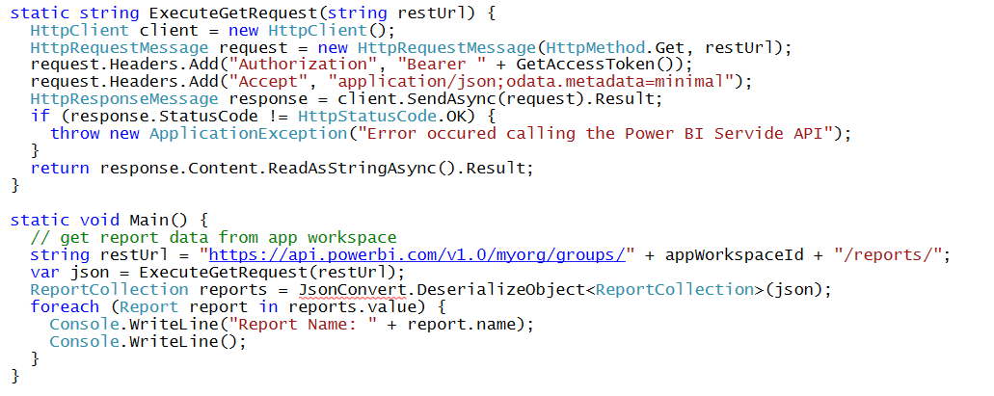
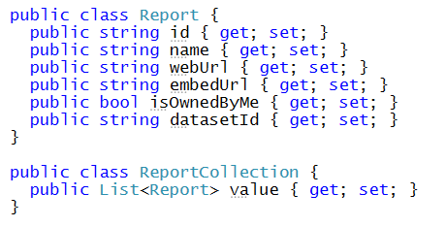
Calling Directly to the Power BI Service API This is a sample of C# code that does not use the Power BI .NET SDK
Your C# Code
Power BI
Service API
Executing HTTP Requests
Capturing HTTP Responses
Serializing/Deserializing JSON

Slide 12
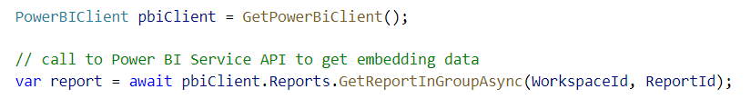
Power BI .NET SDK
Developing without the Power BI .NET SDK
Developing with the Power BI .NET SDK
Your C# Code
Power BI
Service API
Executing HTTP Requests
Capturing HTTP Responses
Serializing/Deserializing JSON
Your C# Code
Power BI
Service API
Power BI .NET SDK
Executing HTTP Requests
Capturing HTTP Responses
Serializing/Deserializing JSON

Slide 13
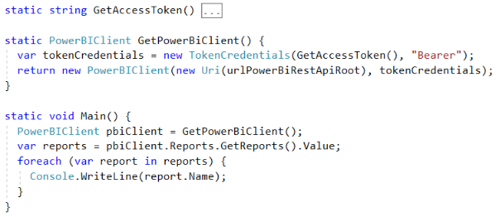
Initializing an Instance of PowerBIClient
PowerBIClient object serves as top-level object
Used to execute calls against Power BI Service
Initialized with function to retrieve AAD access token

Slide 14
User APIs versus Admin APIs
Power BI User APIs (e.g. GetGroupsAsync)
provides users with access to personal workspace
provides users with access to app workspaces
provides service principal (SP) with access to app workspaces
Power BI Admin APIs (e.g. GetGroupsAsAdminAsync)
provides users with tenant-level access to all workspaces

Slide 15
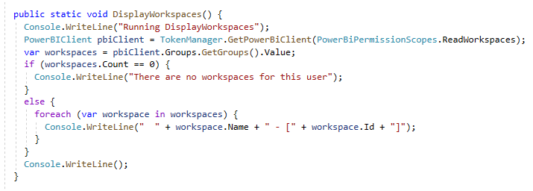
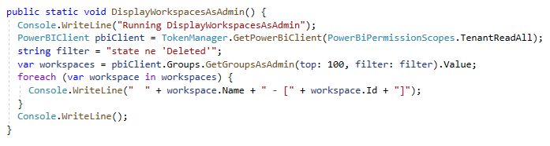
User API versus Admin API

Slide 16
Agenda
Power BI Dataset Programming Overview
Programming Datasets with the PBI REST API
Programming Datasets as Service Principal
Programming Datasets using Tabular Object Model
Scaling with App-Owns-Data in Multi-tenant Scenarios

Slide 17
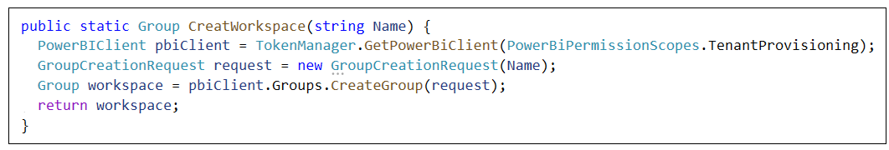
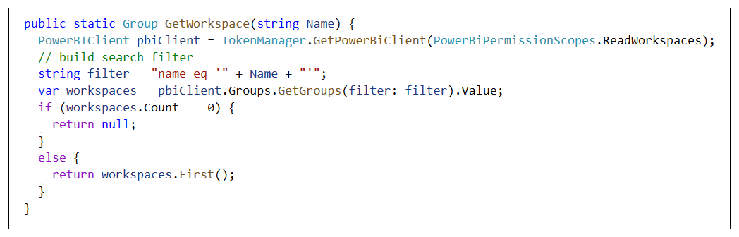
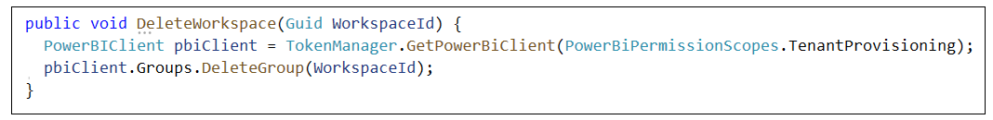
Creating and Managing Workspaces
Creating a new workspace
Getting a workspace by name
Deleting a workspace

Slide 18
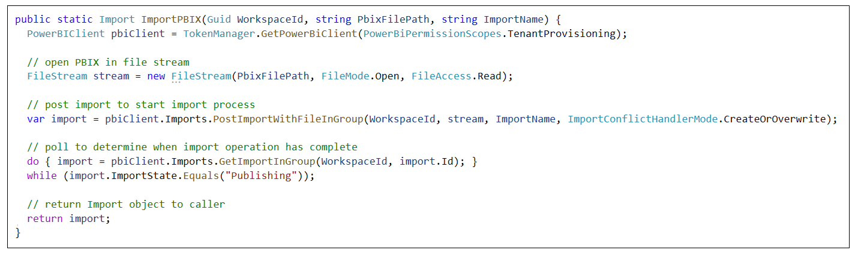
Importing PBIX Files
Importing PBIX from string-based file path

Slide 19
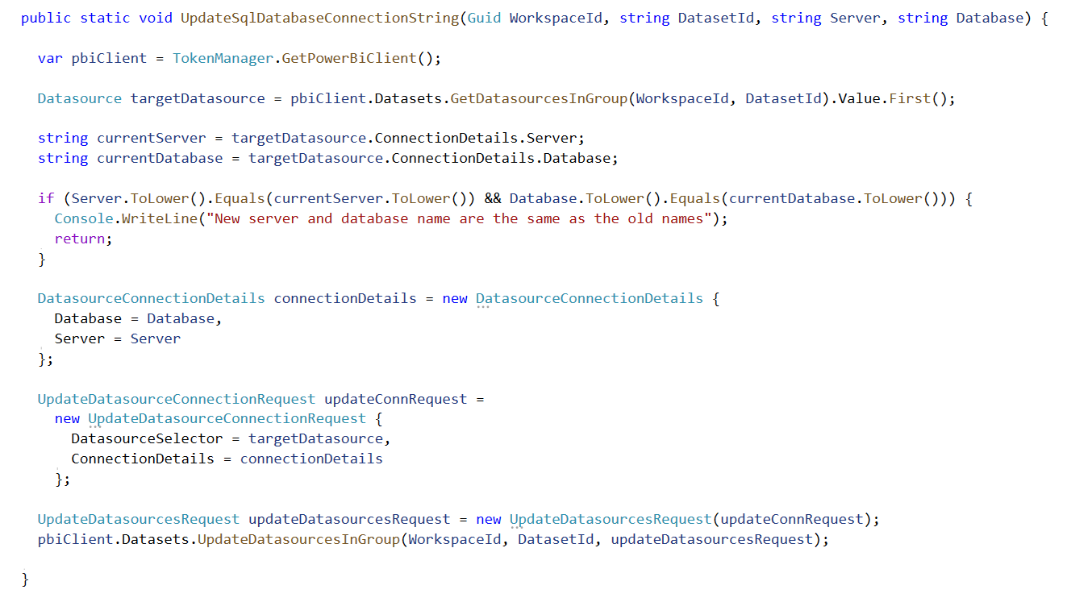
Updating a SQL connection string for a dataset

Slide 20
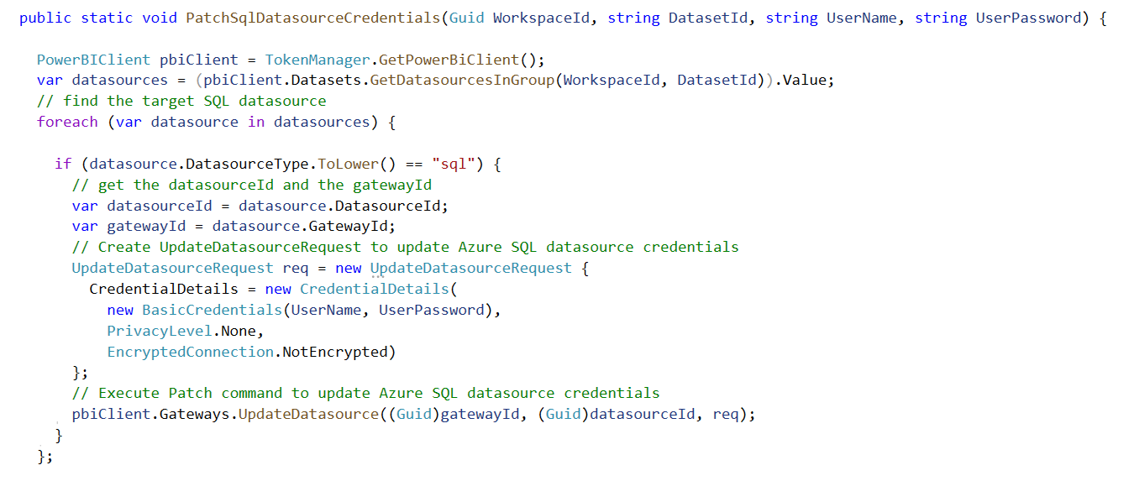
Patching SQL Datasource Credentials

Slide 21
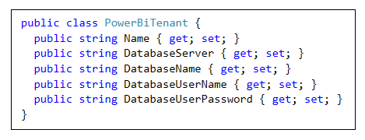
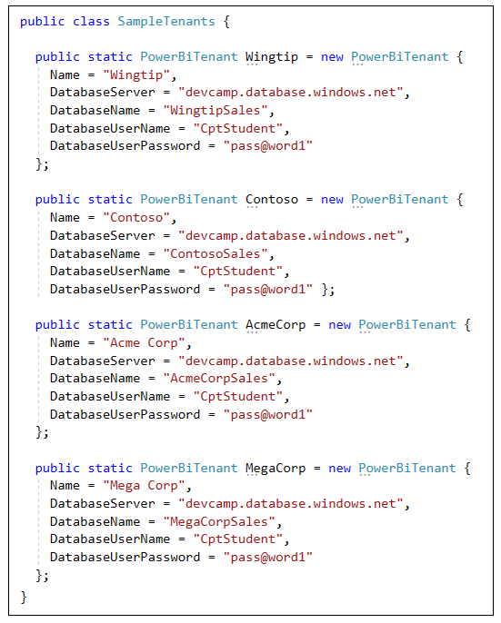
Samples Data for Tenant Provisioning

Slide 22
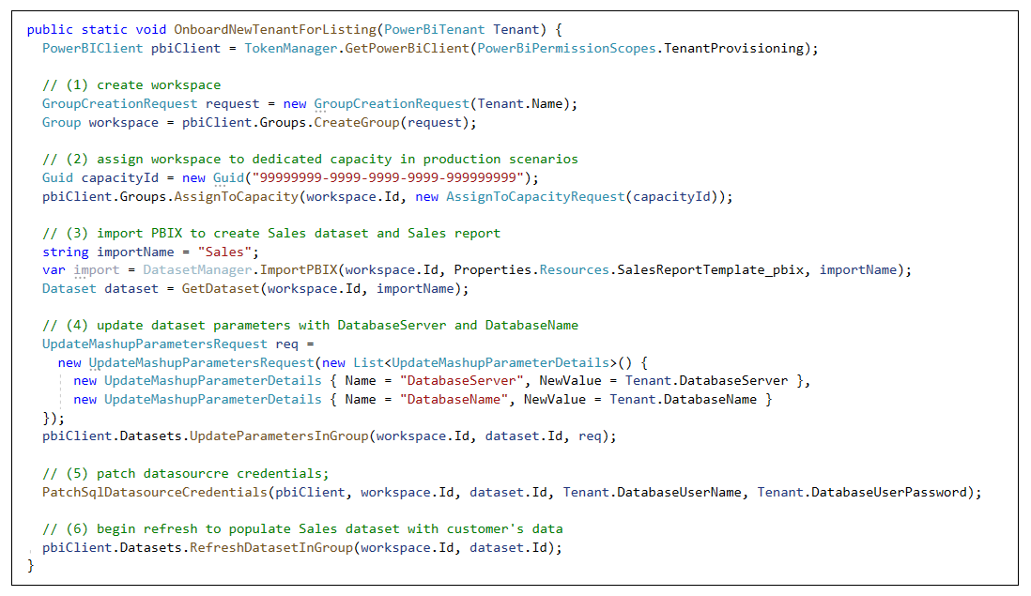
Tenant Provisioning Example

Slide 23
Agenda
Power BI Dataset Programming Overview
Programming Datasets with the PBI REST API
Programming Datasets as Service Principal
Programming Datasets using Tabular Object Model
Scaling with App-Owns-Data in Multi-tenant Scenarios

Slide 24
App-only Access Control
Service Principal used to configure access control
Requires the use of v2 app workspaces
Service principal added to app workspaces as admin
Access control NOT based on Azure AD permissions
App Workspace 1
Admins
User 1
User 2
App 1 Service Principal
Power BI Service
App 1 Service Principal
App-only Access Token
App Workspace 2
Admins
User 1
App 1 Service Principal
App 2 Service Principal

Slide 25
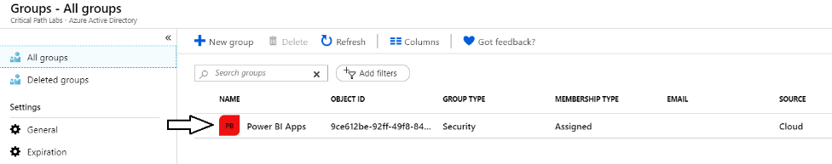
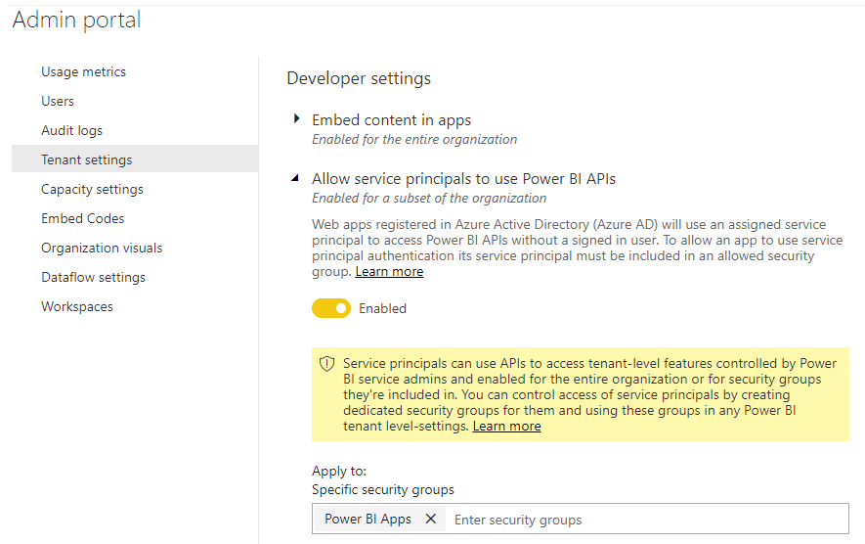
Setting Up for App-Owns-Data – Part 1
Enable Service Principal Access to Power BI Service API
Create an Azure AD security group (e.g. Power BI Apps)
Add group to Power BI Allow service principals to use Power BI APIs

Slide 26
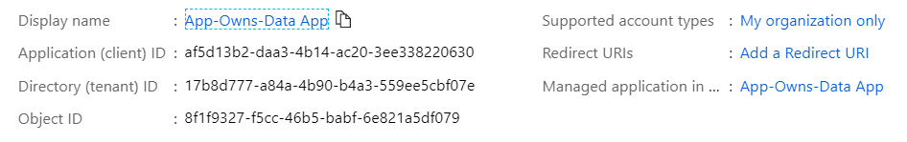
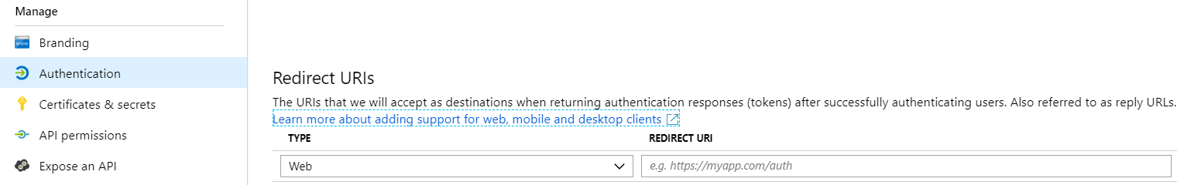
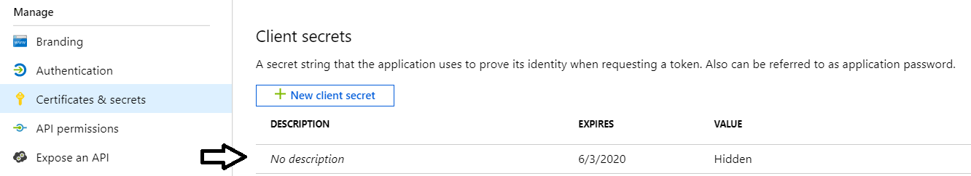
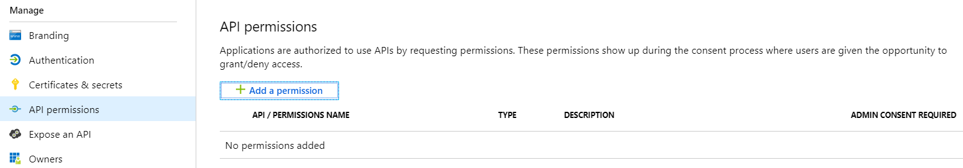
Setting Up for App-Owns-Data – Part 2
Create a confidential client in your Azure AD tenant
Configured as TYPE=Web and no need for a redirect URL
Add a client secret or a client certificate No need to configure any permissions

Slide 27
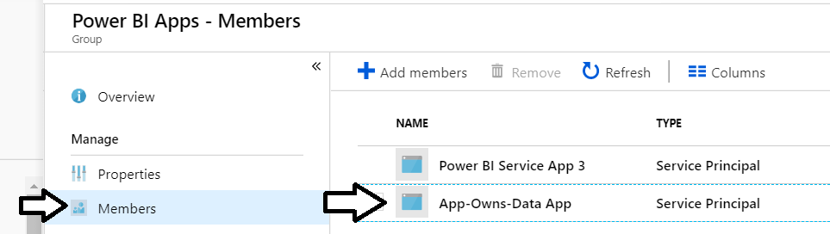
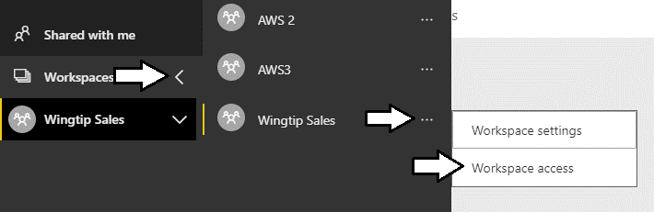
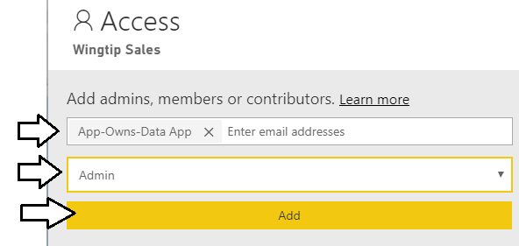
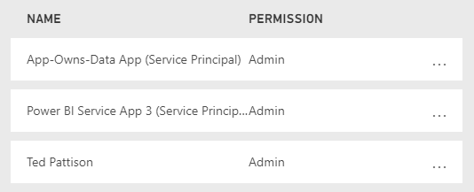
Setting Up for App-Owns-Data – Part 3
Add application's service principal in Power BI Apps security group
Configure application's service principal as workspace admin
Service principal should now be workspace admin

Slide 28
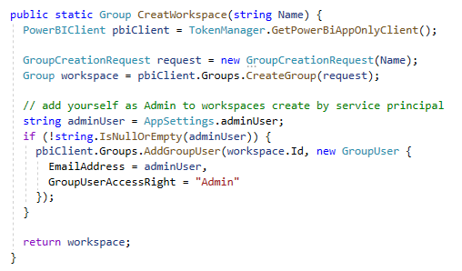
Calling the Power BI REST API as Service Principal

Slide 29
Agenda
Power BI Dataset Programming Overview
Programming Datasets with the PBI REST API
Programming Datasets as Service Principal
Programming Datasets using Tabular Object Model
Scaling with App-Owns-Data in Multi-tenant Scenarios

Slide 30
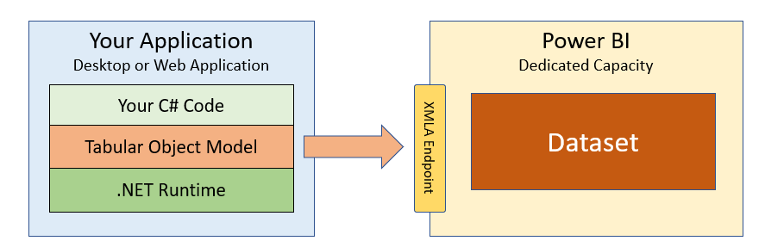
What is the Tabular Object Model (TOM)?
A new API for Power BI developers
Programming model built on XMLA Endpoint
.NET library with abstract layer over XMLA endpoint.
Requires Power BI datasets in a Premium capacity
CAVEAT – datasets modified with TOM cannot be downloaded as PBIX

Slide 31
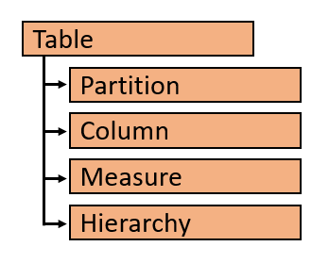
TOM Object Hierarchy

Slide 32
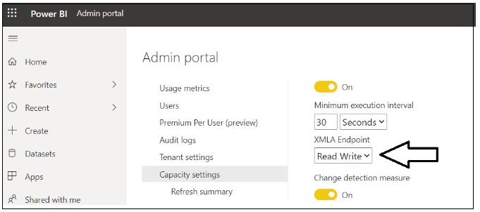
You must enable read/write access

Slide 33
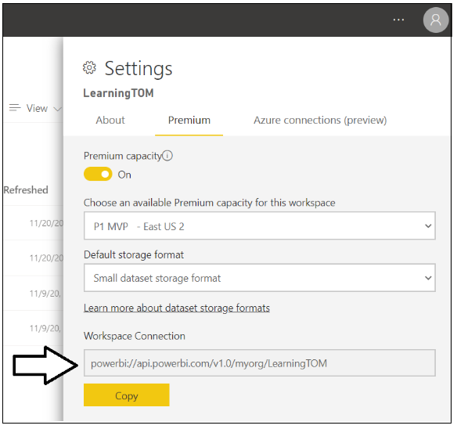
Workspace Connection

Slide 34
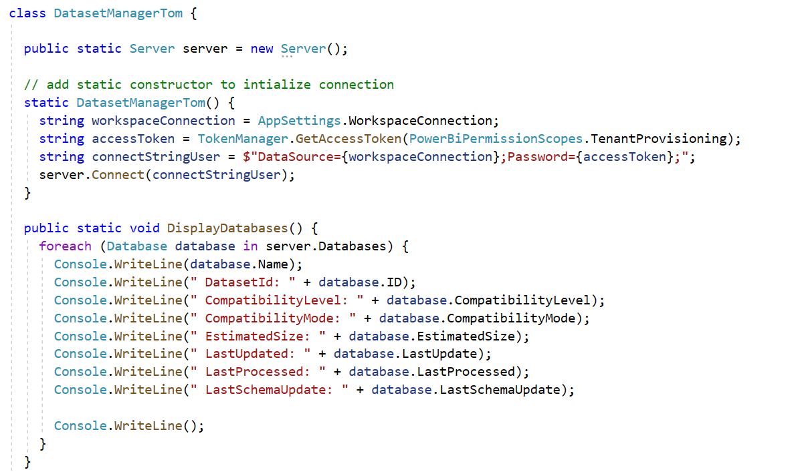
TOM Programming Samples

Slide 35
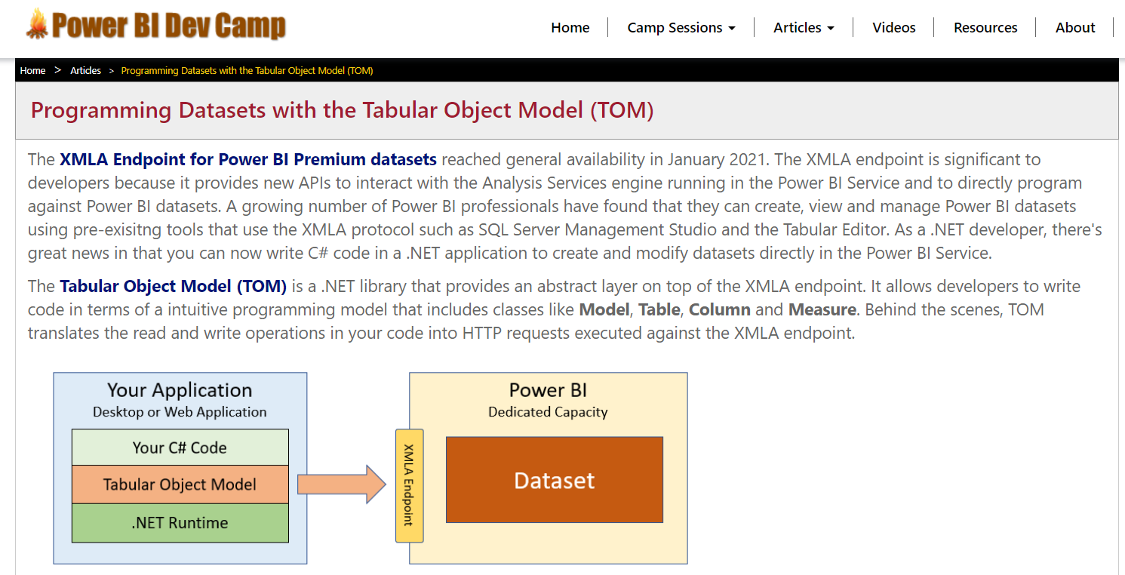
Getting up to speed on TOM
https://www.powerbidevcamp.net/articles/programming-datasets-with-TOM/

Slide 36
Agenda
Power BI Dataset Programming Overview
Programming Datasets with the PBI REST API
Programming Datasets as Service Principal
Programming Datasets using Tabular Object Model
Scaling with App-Owns-Data in Multi-tenant Scenarios

Slide 37
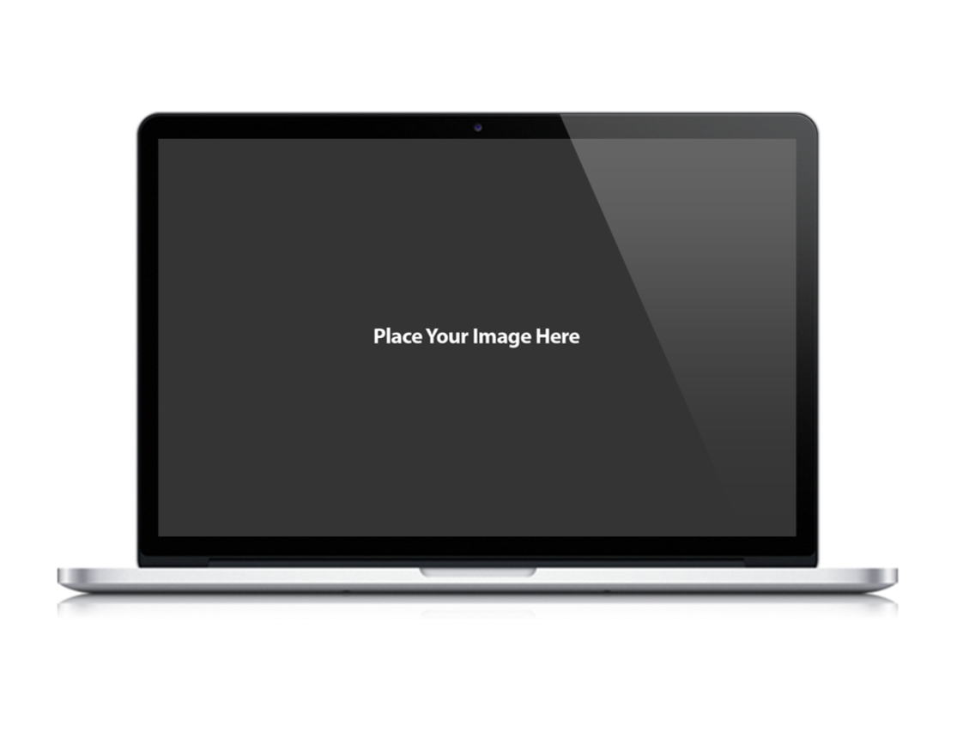
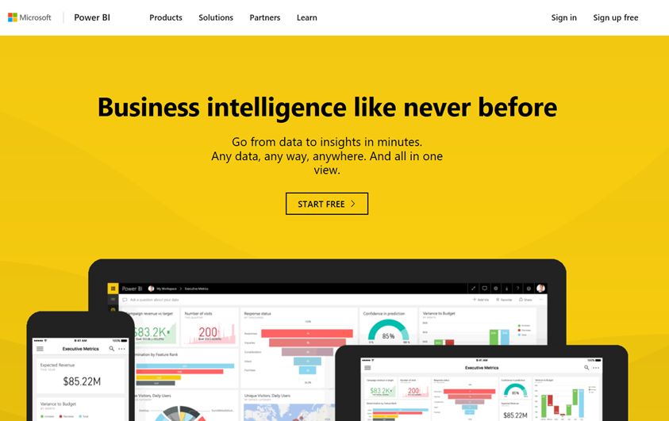
CAT
Microsoft Power BI
App-Owns-Data Starter Kit
Ted Pattison Power BI Customer Advisory Team (PBICAT)

Slide 38
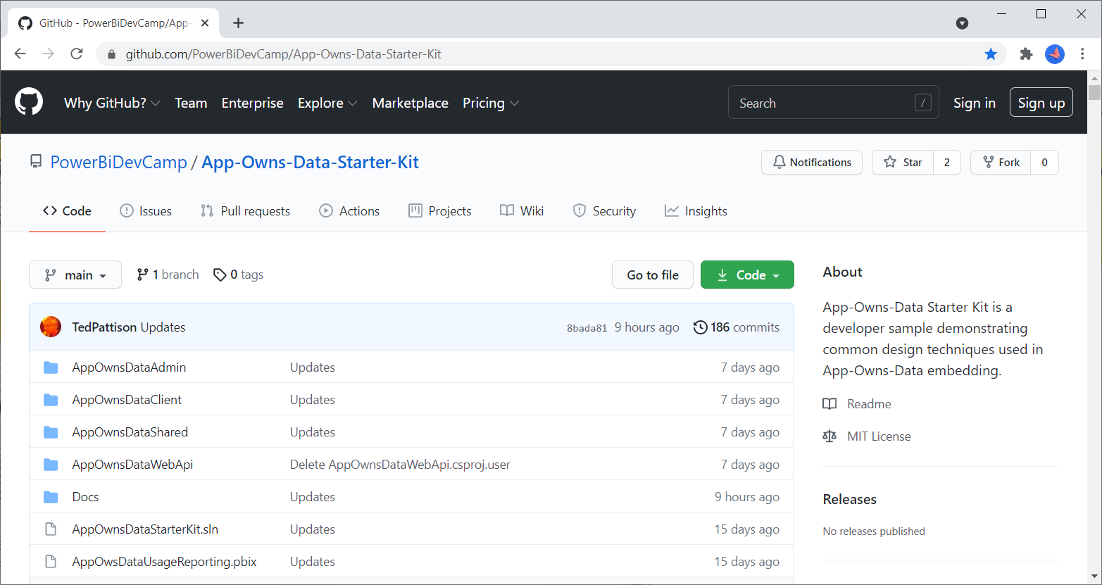
App-Owns-Data Starter Kit on GitHub
https://github.com/PowerBiDevCamp/App-Owns-Data-Starter-Kit

Slide 39

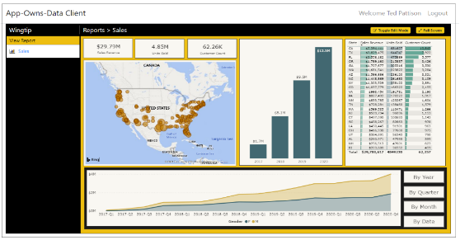
Customer Tenants in App-Owns-Data Embedding
Tenant represents a customer with one or more users
You must create a separate tenant footprint in Power BI for each customer
Power BI environment
Customer 01
17 users
Customer 01 Tenant
Sales
Power BI Workspace
Power BI Dataset
Datasource credentials
Power BI Report

Slide 40
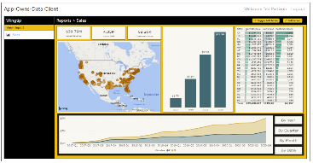
Designing a Multi-tenant Environment
Power BI Multi-tenant environment
Customer 01
17 users
Customer 01 Tenant
Sales
Power BI Workspace
Power BI Dataset
Datasource credentials
Power BI Report
Customer 02
243 users
Customer 02 Tenant
Sales
Power BI Workspace
Power BI Dataset
Datasource credentials
Power BI Report
Customer N
74 users
Customer N Tenant
Sales
Power BI Workspace
Power BI Dataset
Datasource credentials
Power BI Report

Slide 41
Solution Architecture
AppOwnsDataAdmin: administrative app to create tenants and manage user permissions.
AppOwnsDataClient: customer-facing SPA used to view and author reports.
AppOwnsDataWebApi: custom Web API used by the AppOwnsDataClient application.
AppOwnsDataAdmin
AppOwnsDataDB
Power BI REST API
AppOwnsDataClient
AppOwnsDataWebAPI

Slide 42
App-Owns-Data Embedding and Multi-tenancy
Tenant represents a customer with one or more users
you must create a separate tenant for each customer
Provisioning a new customer tenant
create a Power BI workspace
assign workspace to a dedicated capacity
import PBIX files
patch datasource credentials
start dataset refresh operations
create and bind gateway datasources

Slide 43
Web API Architecture
AppOwnsDataClient
AppOwnsDataWebAPI
Power BI REST API
Azure AD Client App
Azure AD Service App
AppOwnsDataDB

Slide 44
App-Owns-Data Starter Kit - Value Proposition
Provides guidance and starter code for the following tasks
Onboarding new customer tenants
Managing user permissions
Implementing the customer-facing client as a Single Page Application (SPA)
Creating a custom telemetry layer to log user activity
Monitoring user actions such as viewing, editing, and creating reports
Monitoring the performance of report loading and report rendering

Slide 45
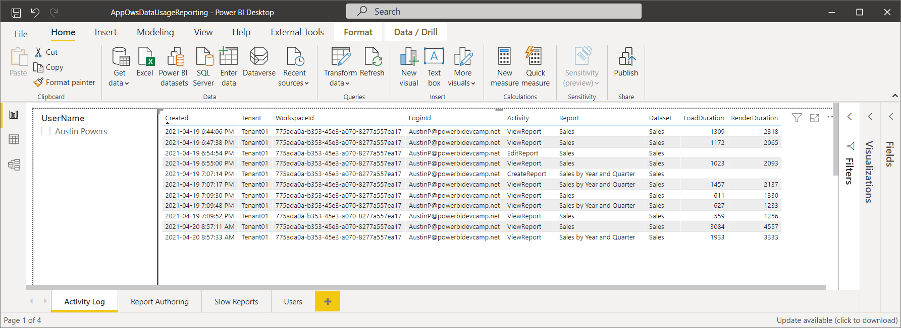
AppOwsDataUsageReporting.pbix

Slide 46
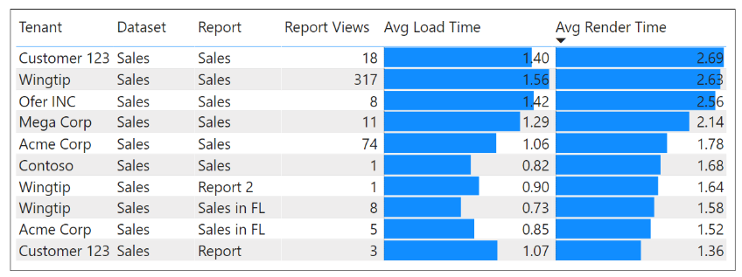
Monitor Report Performance

Slide 47
Summary
Power BI Dataset Programming Overview
Programming Datasets with the PBI REST API
Programming Datasets as Service Principal
Programming Datasets using Tabular Object Model
Scaling with App-Owns-Data in Multi-tenant Scenarios

Slide 48
Microsoft Power BI
Questions?

